Slide 1

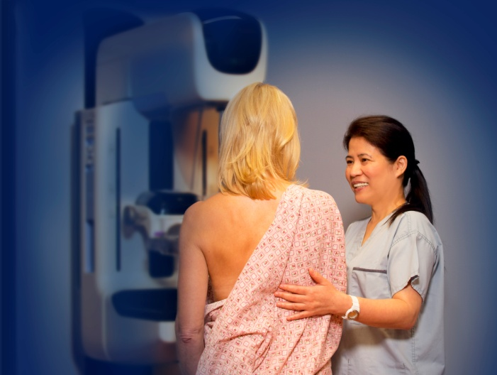

Screening mammography program
Screening Mammography in 2014:
Still Controversial?
Dr. Christine Wilson
Medical Director, Screening Mammography Program
BC Cancer Agency

Slide 2
Faculty/Presenter Disclosure
Faculty: Christine Wilson MD
Relationships with commercial interests:
  Medical Director Screening Mammography Program of BC (www.screeningbc.ca/breast)

Slide 3
Breast Cancer Screening
Background
  SMP QM practices
Controversies
  Overdiagnosis
  Breast density
Informed Decision Making
Notes:
Based on a concensus report from the ON chapter of the CBCF – concise; gives recommendations from experts in the field and in keeping with the CAR and ACR

Slide 4

Organized Screening Programs
There are 4 population-based screening programs in BC:
  Screening Mammography Program (SMP)
  Cervical Cancer Screening Program (CCSP)
  Colon Screening Program
  Hereditary Cancer Program (HCP)
Notes:
Based on a concensus report from the ON chapter of the CBCF – concise; gives recommendations from experts in the field and in keeping with the CAR and ACR

Slide 5
Screening Mammography Program
TARGET POPULATION: Women age 50-69 years
Service also available to women age 40-49 & 70+
SCREENING TEST: Two-view screening mammograms offered across BC
RESULTS: Screen read by a radiologist
Results mailed to both patient and her health care provider
REMINDER: Mailed to patient when time to re-screen
STATISTICS
There are 37 centers and 3 mobiles that perform screening mammography in BC
285,000 mammograms are performed annually
7.5% or ~ 21,400 patients are referred for further investigation
Every year, approximately 1,400 cancers are found by screening
81% of cancers are found in women age 50 and over
Participation rate for ages 50-69 is about 52%
Notes:
Based on a concensus report from the ON chapter of the CBCF – concise; gives recommendations from experts in the field and in keeping with the CAR and ACR

Slide 6
Screening Mammography Program
Screener QA process – initial
  2 years of clinical experience and read 2500 mammograms
  40 hours of Category 1 breast imaging credits in past 5 yrs
  Attendance at 2 formal mammography training courses of 2 to 3 days duration with a screening mammography component – at least one within past 3 yrs
  Pass a standardized test of 100 cases
Notes:
Sensitivity above 85% with no obvious cancers missed; specificty above 45% and above 65% in exclusion of benign lesions; Sept 2014 – 85 active screeners

Slide 7
Screening Mammography Program
Screeners QA process – ongoing
  Read a minimum of 2500 cases per year
  Attend an annual conference in breast imaging (SMP Forum every other year)

Slide 8
Screening Mammography Program
Screeners QA process – ongoing
  Statistics kept on abnormal call rate, cancer detection rate, PPV, sensitivity and specificity and given to each screener annually
  All are expected to maintain benchmarks:
    Standardized cancer detection rate > 5/1000
    Proportion of early stage cancer >60% (DCIS & IDC <15mm)
    Standardized abnormal call rate <2/1000

Slide 9
SMP Performance vs Canadian Standards Women 50 - 69
 | National Standards | BC
Abnormal Call Rate
First Screens | <10% | 17.8%
Subsequent | <5% | 6.3%
Inv Ca DR/1000
First Screens | >5.0/1000 | 7.8
Subsequent | >3.0/1000 | 3.9
Inv Tumour size <10mm | >25% | 35%
Inv Tumour size <15mm | >50% | 62%
Node –ve Cases of Inv Ca | >70% | 78%
Notes:
Results from 2013 Annual Report

Slide 10
SMP Performance vs Canadian Standards Women 50 - 69
 | National Standards | BC
Diagnostic Interval
No biopsy | >90% in 5 weeks | 81.3%
Biopsy | >90% in 7 weeks | 63.6%
Benign Core Biopsy Rate/1000
First Screens |  | 26.4/1000
Subsequent Screens |  | 6.3/1000
Benign/Malignant Core Biopsy
First Screens |  | 5.6/1000
Subsequent Screens |  | 1.6/1000
Benign/Malignant Open Biopsy
First Screens | <1:1 | 4.1:1
Subsequent Screens | <1:1 | 2.8:1
Notes:
Results from 2013 Annual Report

Slide 11
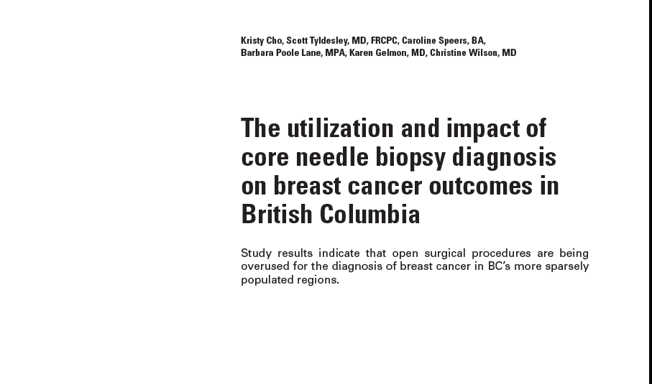
Diagnostic Interval
May 2014
Notes:
May 2014

Slide 12
Diagnostic Interval
2589 women in BC in 2006 with Breast cancer
Diagnosis by core biopsy in 58.9%
Regional variation from 46.7% to 75.4%
Women with diagnosis by core biopsy had fewer total surgeries but no difference in relapse rate or prevalence of pNOi+ disease on SLN biopsy

Slide 13
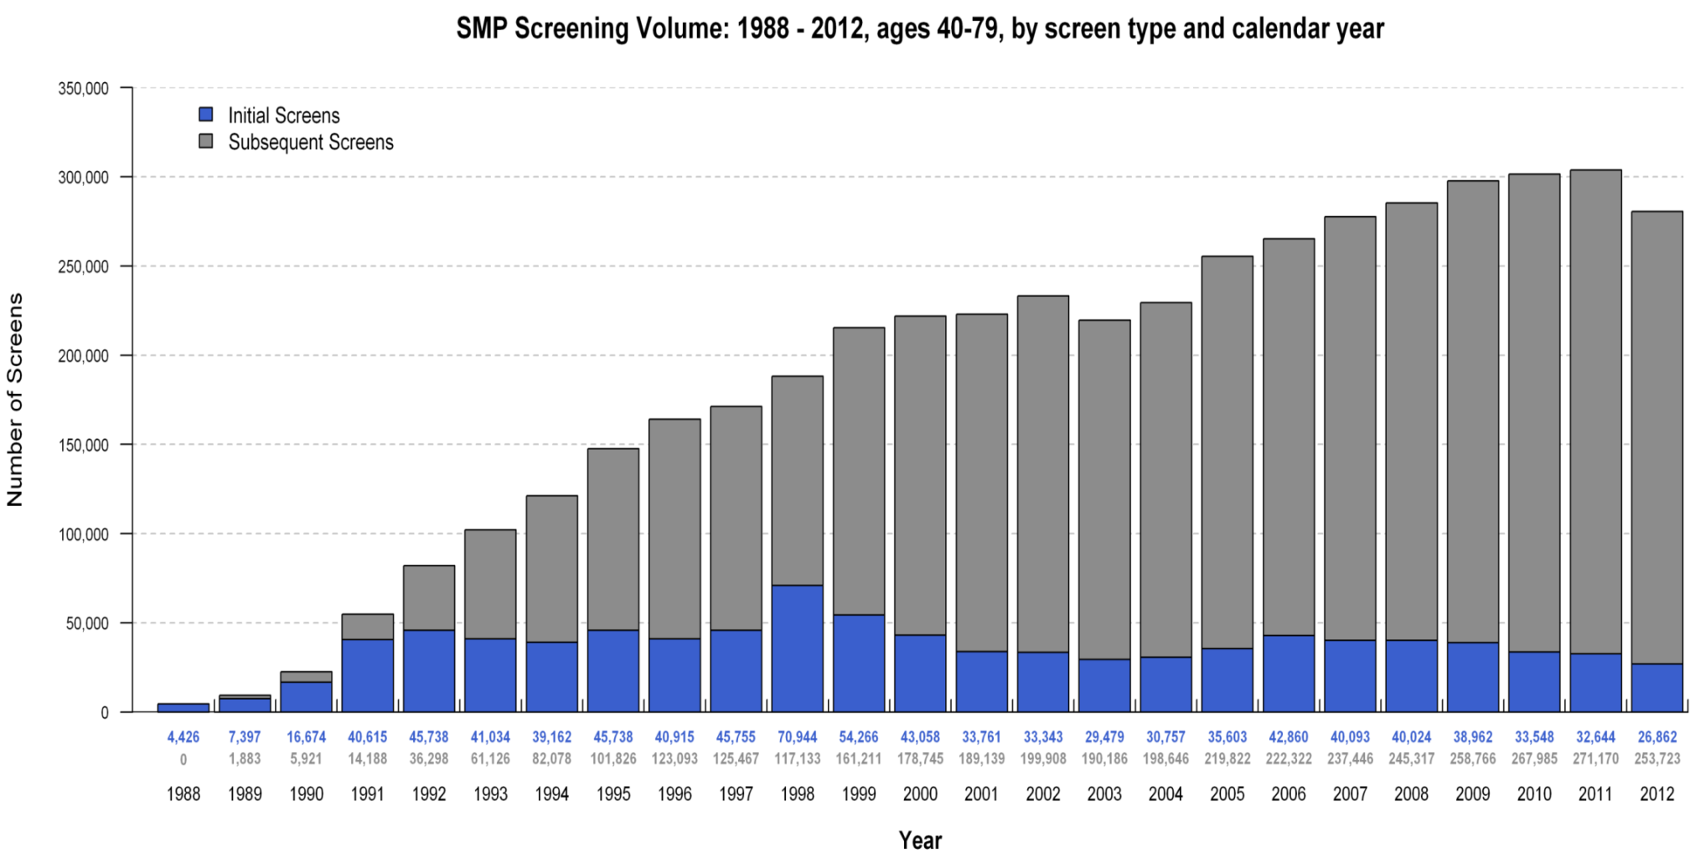
SMP Screening Volumes

Slide 14
SMP Screening Participation

Slide 15
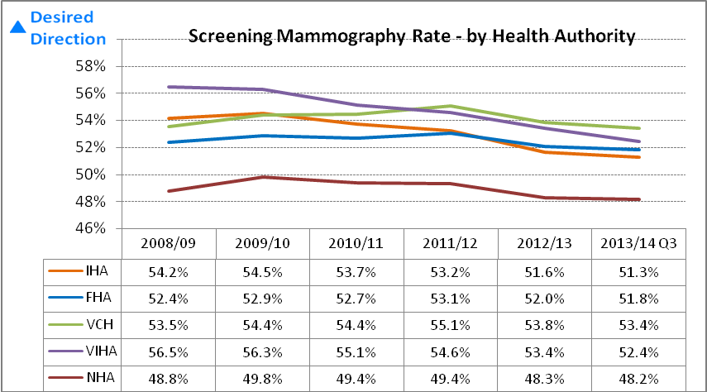
Participation Rates in SMP

Slide 16
Relative Survival Breast Cancer (women) %
Analysis of Population-based Cancer Registry Data
 | Australia | Canada | BC | Denmark | Norway | Sweden | UK
1 Year
1995-99 | 95.8 | 95.9 | 97.1 | 93 | 95.4 | 97.6 | 90.4
2000-02 | 96.3 | 96.2 | 96.5 | 94.3 | 95.8 | 98.4 | 92.4
2005-07 | 96.7 | 96.3 | 97.1 | 95.0 | 96.6 | 98.0 | 94.2
5 Years
1995-99 | 85.0 | 85.3 | 87.1 | 76.9 | 81.8 | 86.7 | 74.8
2000-02 | 87.0 | 86.4 | 87.5 | 81.5 | 83.8 | 89.3 | 78.8
2005-07 | 88.1 | 86.3 | 89.1 | 82.4 | 85.5 | 88.5 | 81.6
Coleman et al
Lancet Dec 2010
Notes:
5 yr survival conditional on survival to the 1st anniversary of diagnosis; Cancer survival in Australia, Canada, Denmark, Norway,
Sweden, and the UK, 1995–2007 (the International Cancer Benchmarking Partnership): an analysis of population-based
cancer registry data; Lancet Dec 2010.
M P
16

Slide 17
Breast Cancer Screening
Over Diagnosis - a neoplasm that would never become clinically apparent without screening before a patient’s death.
Currently no way to confidently distinguish those cancers that are occult from those that will progress so all are treated
*National Cancer Institute website – April 7, 2014

Slide 18
Breast Cancer Screening – Over Diagnosis
BC data
Incidence rates of breast cancer before and after initiation of population screening
Participation-based estimates of over diagnosis to be 5.4% for invasive disease alone and 17.3% when DCIS was included.

Slide 19
Breast Cancer Screening – Over Diagnosis
Participants had higher rates than non participants but lower rates after screening stopped
Population incidence rates for invasive cancer increased after 1980
By 2009 returned to 1970’s levels in women under 60
Remained elevated in women 60 to 79

Slide 20
Breast Cancer Screening – Over Diagnosis
Rates of DCIS increased in all groups
Extent of over diagnosis of IC modest and occurred in women over 60 y – should be considered in screening decisions
Incidence of breast cancer and estimates of over diagnosis after the initiation of population based screening program – A. Coldman and N. Phillips, CMAJ, July 9, 2013.

Slide 21
US Breast Density Legislation
Connecticut, Texas, Virginia, California and New York
Require radiologists to notify women with dense breasts on screening mammograms of the limitations of mammography in identifying tumours in the breast
Only Connecticut law requires insurance companies to cover U/S screening of entire breast if density is BIRADS 3 or 4

Slide 22
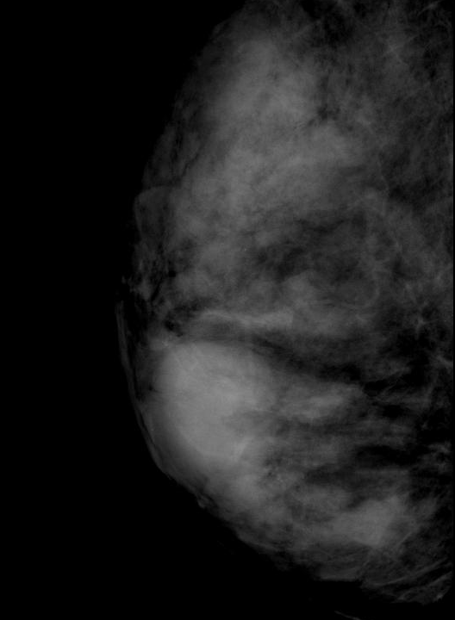
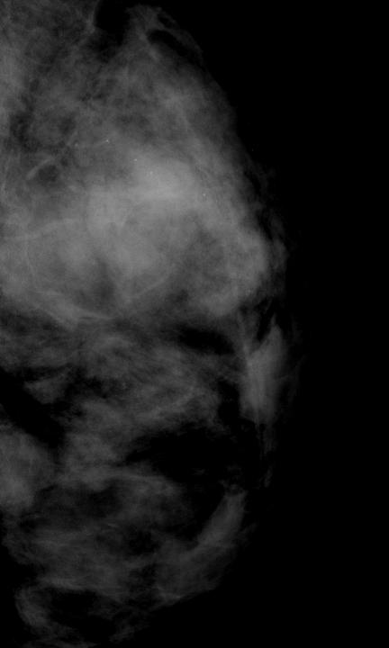
Rt MLO
Lt MLO
Notes:
Heterogeneously dense – BIRADS 3 density

Slide 23
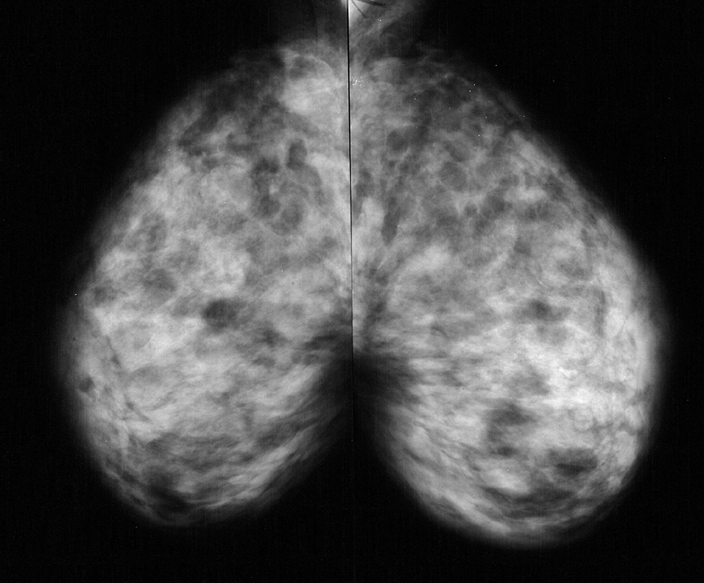
Rt MLO
Lt MLO
Notes:
Extremely dense breast tissue BIRADS 4

Slide 24
US Breast Density Legislation
Legislation is pending in 16 states
A bill has been introduced in the House of Representatives (HR 3102)
In Texas legislation promotes a dialogue between women and their physicians to find the most effective clinical pathway

Slide 25
US Breast Density Legislation
Connecticut Outcomes
  First year of screening revealed an additional 3.2 cancers per 1000 women screened with U/S in addition to mammography
  Similar to other screening U/S studies
  ACRIN 666 resulted in 4 times as many false positives as mammography alone ( 1 in 10 women had an unnecessary biopsy)
Notes:
ACRIN- mammography resulted in 1 in 40 unnecessary biopsies

Slide 26
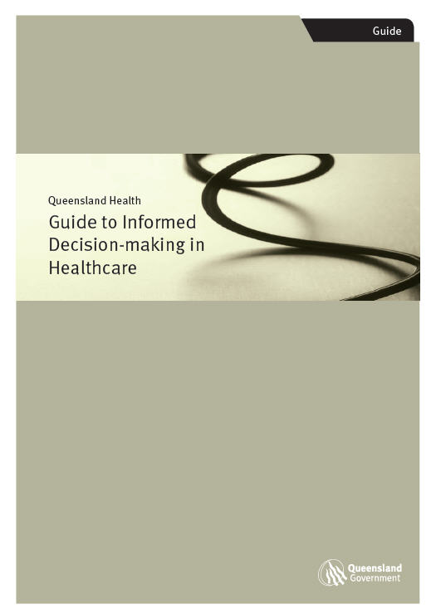
Informed Decision Making
Why informed decision making?
Informed decision making broadens the approach beyond consent
It provides information to support a patient to make a decision about the healthcare offered e.g. should I have this test or not?
It is the foundation of patient centered care
It takes in to account a patient’s values, beliefs and priorities
Notes:
Informed decision making materials provide a “contemporary, patient focused approach” – Queensland healthcare Policy

Slide 27
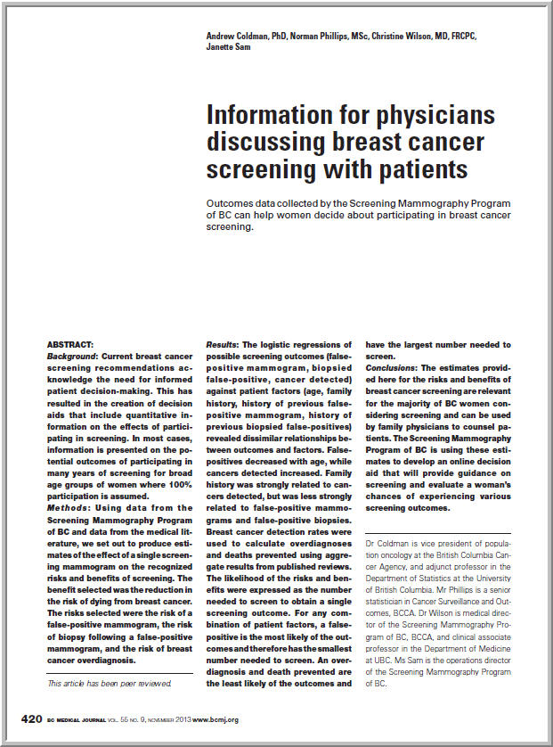
Informed Decision Making:
Communicating Benefits & Limitations
In 2013 the BC Cancer Agency published a peer reviewed article “Information for physicians discussing breast cancer screening with Patients”. BC Medical Journal
Used data from the Screening Mammography Program of BC and data from the medical literature to produce estimates of the effect of a single screening mammogram on the recognized risks and benefits of screening.
Available on www.screeningbc.ca/breast
Notes:
UK Marmot review

Slide 28
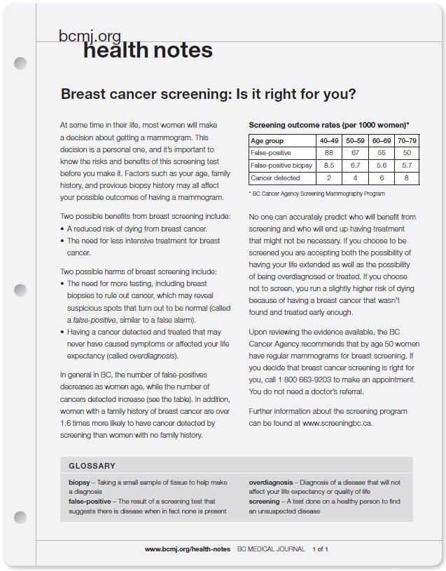
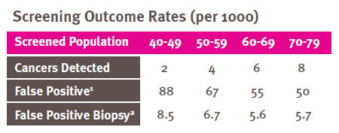
Informed Decision Making:
Communicating Benefits & Limitations
The BCMJ felt the information would be widely appreciated by physicians and developed a supporting tool doctors could use to share the information with their patients
Reviews the benefits and harms of screening
Available at www.screeningbc.ca/breast
Notes:
UK Marmot review

Slide 29
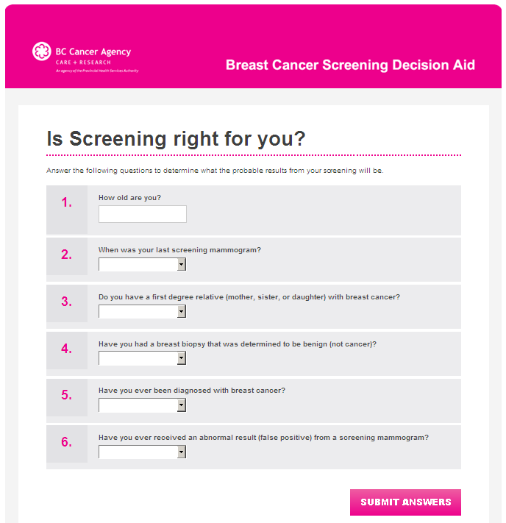
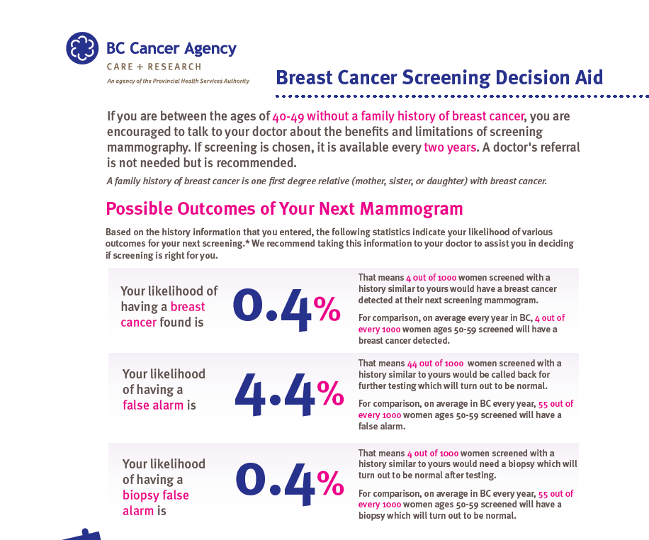
Informed Decision Making:
Communicating Benefits & Limitations
Online Breast Cancer Decision Aid: www.screeningbc.ca/breast
Notes:
UK Marmot review

Slide 30
Breast Screening: False Positives
Age group | 40-49 | 50-59 | 60-69 | 70-79
False +ve | 88 | 67 | 55 | 50
False +ve biopsy | 8.5 | 6.7 | 5.6 | 5.7
Cancer detected | 2 | 4 | 6 | 8
* Per 1000 women screened – BCCA SMP

Slide 31
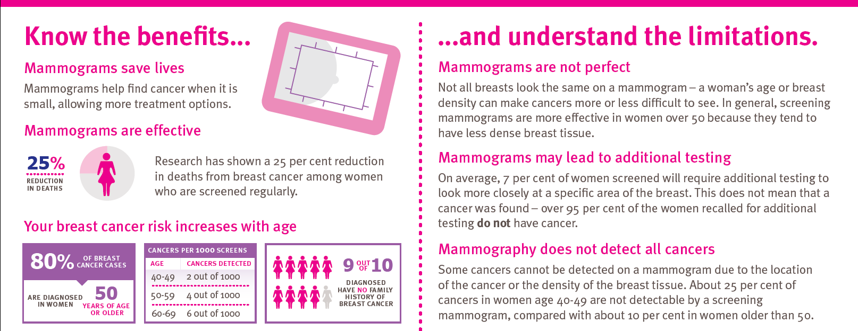
Informed Decision Making:
Communicating Benefits & Limitations

Slide 32
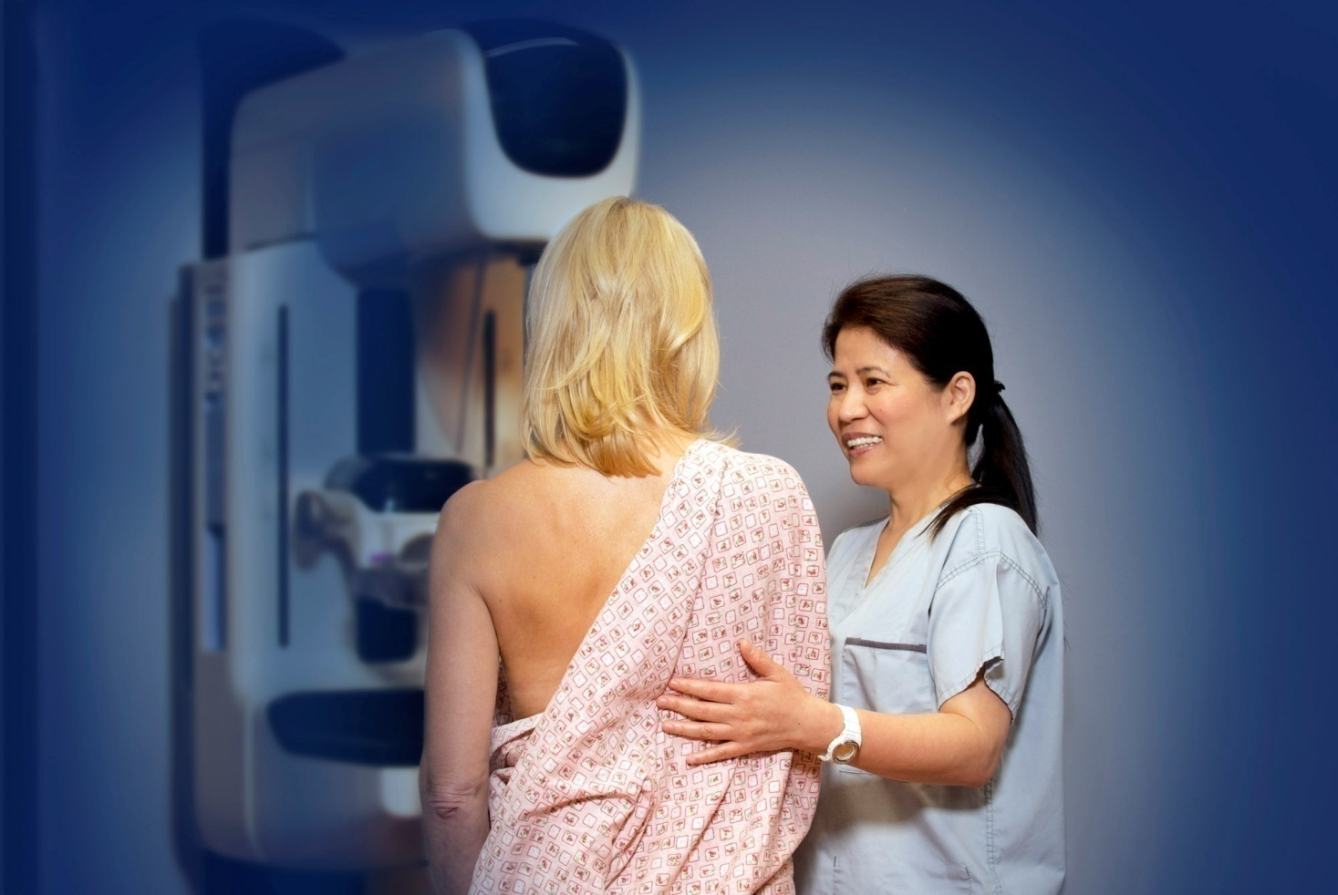
British Columbia’s Updated Breast Screening Policy:
Implemented February 2014

Slide 33
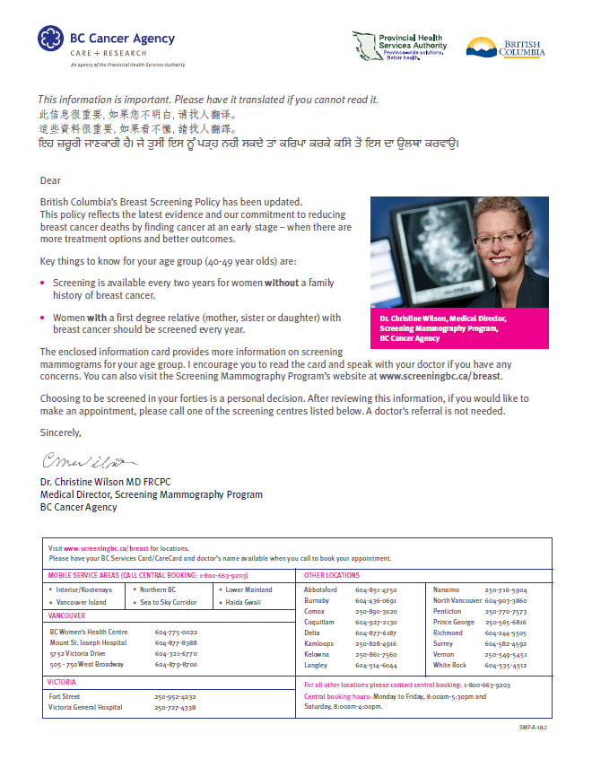

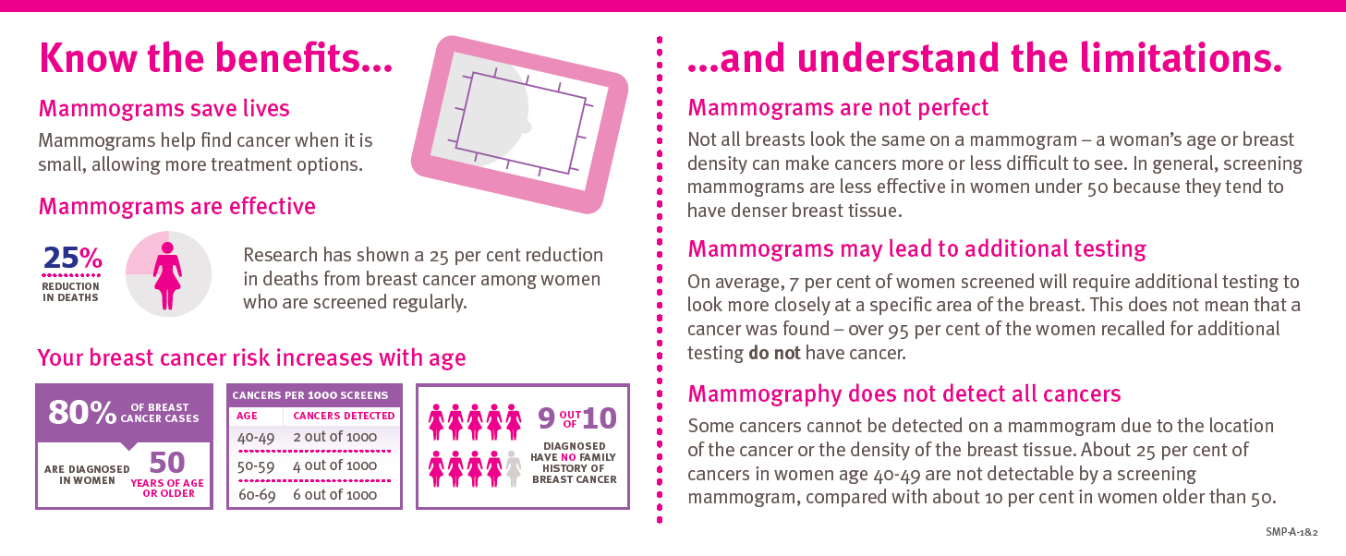
British Columbia’s Updated Breast Screening Policy:
Postcard and Letter: Reminder & Recall

Slide 34

British Columbia’s Updated Breast Screening Policy:
Higher than Average Risk – Annual Recall
Routine screening mammograms are recommended every year. The patient will be recalled by the program at the recommended interval.
A health care provider’s referral is not required.

Slide 35
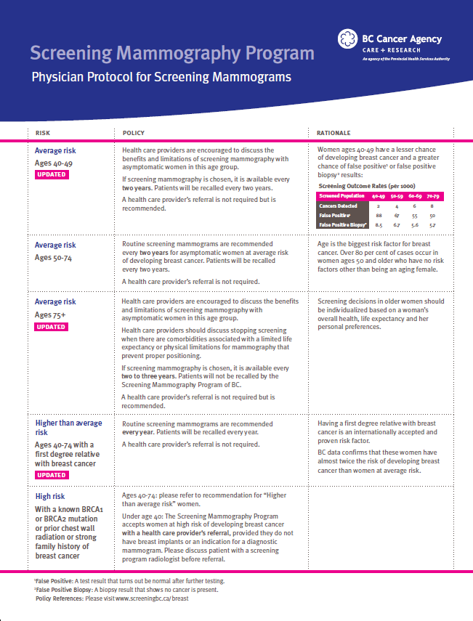
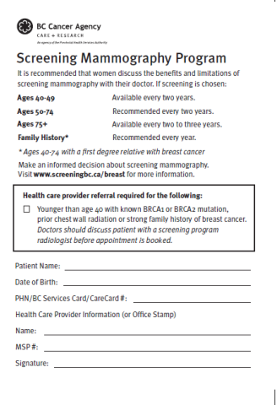
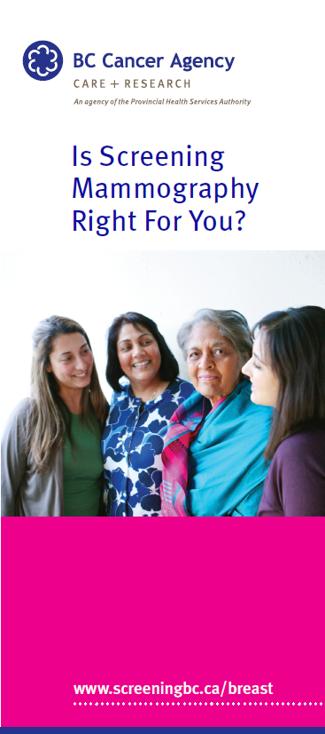
British Columbia’s Updated Breast Screening Policy:
New Promotional Materials
New materials developed to reflect new policy.
Tested with eligible women and primary care providers.
New materials include information on the benefits and limitations of screening
Notes:
New promotional materials have been developed….

Slide 36

Questions?
Dr. Christine M. Wilson MD FRCPC
Medical Director , SMP
Email: cwilson4@bccancer.bc.ca

